Slide 1
Expert Systems in AI
By
Adnan Majeed
Data Scientist & Researcher

Slide 2
Expert systems are a crucial subset of artificial intelligence (AI) that simulate the decision-making ability of a human expert. These systems use a knowledge base filled with domain-specific information and rules to interpret and solve complex problems. For example, a medical expert system can analyze a patient’s symptoms and suggest possible diagnoses or treatments. Similarly, a financial expert system can evaluate market trends and recommend investment strategies.
The key idea behind expert systems is to preserve and replicate human expertise. This is especially useful in fields where expert knowledge is scarce or expensive.

Slide 3
Why Are Expert Systems Important?
Preserving Expertise: They capture the knowledge of human experts and store it in a digital format. This ensures that valuable expertise isn’t lost when an expert retires or leaves.
Improving Decision-Making: By relying on data and rules, expert systems provide consistent and unbiased recommendations.
Saving Time and Money: They automate tasks that would otherwise require human intervention, reducing costs and increasing efficiency.
Accessibility: Expert systems make expert-level knowledge available to non-experts, democratizing access to specialized information.

Slide 4
1. Knowledge Base: The Heart of the System
The knowledge base is the heart of an expert system. It contains all the facts, rules, and expert knowledge related to a specific domain. Think of it as a library filled with textbooks, research papers, and expert opinions. The accuracy and completeness of the knowledge base directly impact the system’s performance. If the knowledge is outdated or incomplete, the system’s recommendations may be flawed.
In a financial expert system, the knowledge base might include rules for detecting fraudulent transactions, such as "If a transaction exceeds $10,000 and occurs in a foreign country, flag it for review."

Slide 5
Inference Engine: The Brain Behind the Decisions
The inference engine is the brain of the expert system. It processes the information stored in the knowledge base to draw conclusions or make recommendations. The inference engine uses reasoning strategies (like forward chaining or backward chaining) to analyze data and apply rules.
Forward Chaining: Starts with available data and works toward a conclusion. For example, "If the temperature is high and the patient has a cough, diagnose a respiratory infection."
Backward Chaining: Starts with a goal and works backward to find supporting evidence. For example, "If the goal is to diagnose diabetes, check for symptoms like frequent urination and high blood sugar."

Slide 6
User Interface: Bridging the Gap Between System and User
The user interface is the bridge that allows users to interact with the expert system. It’s designed to be intuitive and user-friendly, ensuring that even non-experts can use the system effectively. Users provide a query (problem or question), and the system processes the request. The system then delivers advice or recommendations back to the user.

Slide 7
Explanation Module: Building Trust Through Transparency
This transparency is especially important in fields like healthcare and finance, where decisions can have significant consequences.
Example: A medical expert system might explain, "I diagnosed pneumonia because the patient has a fever, cough, and abnormal chest X-ray."

Slide 8
Knowledge Acquisition Module: Keeping the System Up-to-Date
The knowledge acquisition module is responsible for updating and expanding the knowledge base. It ensures that the system stays current with the latest information and trends. Without regular updates, the system’s knowledge base can become outdated, reducing its effectiveness.

Slide 9
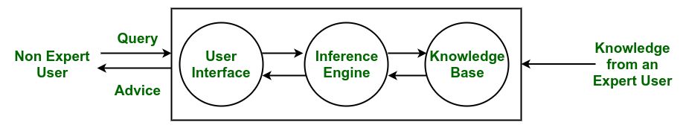

Slide 10
The working mechanism of an expert system begins when a non-expert user submits a query through the user interface.
This query is then processed by the inference engine, which applies logical rules and reasoning techniques to analyze the input.
The inference engine interacts with the knowledge base, retrieving relevant facts, rules, and heuristics contributed by expert users.
Based on this structured knowledge, the system derives conclusions and formulates an appropriate response.

Slide 11
Reasoning Strategies used by Inference Engine
1. Forward Chaining
This is a data-driven reasoning approach where the system starts with the available facts and applies rules to infer new facts or conclusions. It's typically used to predict outcomes or determine what will happen next. An example given is predicting stock market movements.

Slide 12
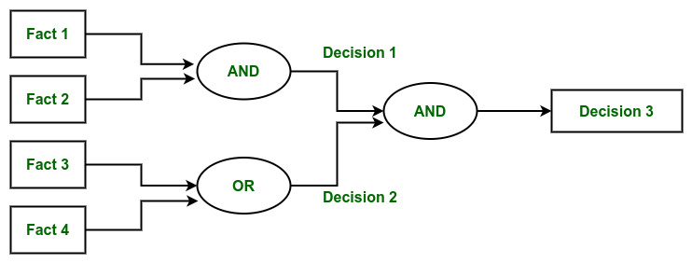

Slide 13
2. Backward Chaining
This is a goal-driven reasoning approach where the system starts with a hypothesis or a goal (something to prove) and works backward to determine which facts or conditions would support that conclusion. It's often used to diagnose issues by determining the cause of an observed effect. The examples provided include diagnosing medical conditions like stomach pain, blood cancer, or dengue.

Slide 14
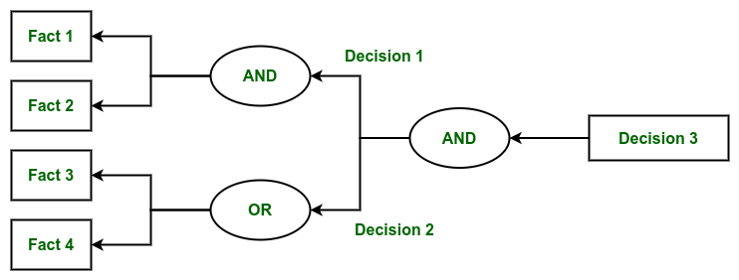

Slide 15
How These Components Work Together?
Input: A patient reports symptoms like fever, cough, and fatigue through the user interface.
Processing: The inference engine analyzes the symptoms using rules from the knowledge base.
Output: The system suggests a possible diagnosis, such as pneumonia.
Explanation: The explanation module provides a detailed explanation, such as "The diagnosis is based on the presence of fever, cough, and abnormal chest X-ray results."
Update: The knowledge acquisition module adds new data, such as recent research on pneumonia treatments, to keep the system up-to-date.

Slide 16
Types of Expert Systems in AI
Rule-Based Expert Systems
One of the most common types is Rule-Based Expert Systems, which rely on if-then rules to process information and make decisions. These rules are typically crafted by domain experts and serve as the system’s reasoning mechanism. A well-known example is MYCIN, an early medical diagnosis system that identified bacterial infections.

Slide 17
Frame-Based Expert Systems
Another category is Frame-Based Expert Systems, which organize knowledge using frames, similar to objects in programming. These frames store attributes and values related to specific concepts, making them useful in natural language processing and other knowledge representation tasks.

Slide 18
Fuzzy Logic Systems
For situations involving uncertainty and imprecision, fuzzy logic Systems come into play. These systems don’t operate on strict true/false values but instead allow for degrees of truth. Fuzzy control systems, commonly used in household appliances like washing machines and air conditioners, leverage this approach to optimize performance based on variable input conditions.

Slide 19
Neural Network-Based Expert Systems
Integrate artificial neural networks to learn patterns from data and improve decision-making. These systems are widely used in applications like image recognition and speech processing, where traditional rule-based approaches might struggle.
5. Neuro-Fuzzy Expert Systems
A more advanced hybrid approach is Neuro-Fuzzy Expert Systems, which merge the learning capabilities of neural networks with the uncertainty-handling strengths of fuzzy logic. These systems are particularly useful in financial forecasting and automated control systems, where both structured learning and flexible reasoning are necessary.

Slide 20
Applications of Expert Systems
Medical Diagnosis: Expert systems assist doctors by analyzing symptoms and medical history to suggest possible diagnoses or treatment options. For example, MYCIN, an early expert system, helped identify bacterial infections and recommend antibiotics.
Financial Services: In finance, expert systems are used for credit scoring, fraud detection, and investment advice. They analyze financial data and patterns to make informed decisions.
Technical Support: Expert systems can troubleshoot and provide solutions for technical issues. They guide users through problem-solving steps based on pre-defined rules and knowledge.
Manufacturing: In manufacturing, expert systems help optimize production processes, perform quality control, and manage inventory by analyzing data and making recommendations.

Slide 21
Benefits of Expert Systems
Consistency: Expert systems provide consistent and reliable recommendations, reducing the variability that can occur with human decision-making.
Availability: They are available 24/7 and can handle multiple queries simultaneously, providing timely assistance and support.
Cost-Effectiveness: By automating expert-level decision-making, organizations can save on the costs associated with hiring and training human experts.
Knowledge Preservation: Expert systems preserve valuable knowledge and expertise, making it accessible even if the original experts are no longer available.

Slide 22
Limitations of Expert Systems
Knowledge Limitation: The effectiveness of an expert system depends on the completeness and accuracy of the knowledge base. If the knowledge is outdated or incomplete, the system's performance may be compromised.
Lack of Flexibility: Expert systems are limited to the rules and knowledge they are programmed with. They may struggle with novel or ambiguous situations that fall outside their predefined rules.
Maintenance: Regular updates and maintenance are required to keep the knowledge base current and relevant, which can be resource-intensive.

